Slide 1

Why Multiple Linear Regression
So far, we have seen the concept of simple linear regression where a single Independent variable X was used to model the Dependent variable Y .
But in many applications, there is more than one factor that influences the response.
e.g.,
Price of a house depends on multiple factors:
1. Location
2. Age
3. no.of rooms .,etc

Slide 2
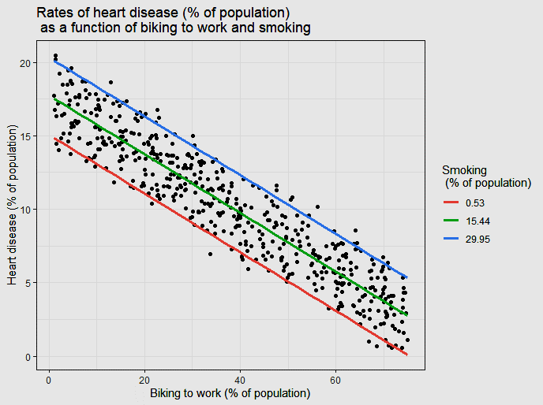
What is Multiple Linear Regression
Multiple regression model describe how a single Dependent variable Y depends linearly on a number of Independent variables X. It try to fit the model with multiple Independent Variables.
y = m1x1 + m2x2 + ... + mnxn + c
where c=c1+c2+...+cn

Slide 3

Multiple Linear Regression
Advantage
Dis-Advantage
The ability to determine the relative influence of two or more Independent variables(X) to the Dependent variables(Y).
1. It'll fit the data with linear relation even if the data is not linearly distributed.

Slide 4
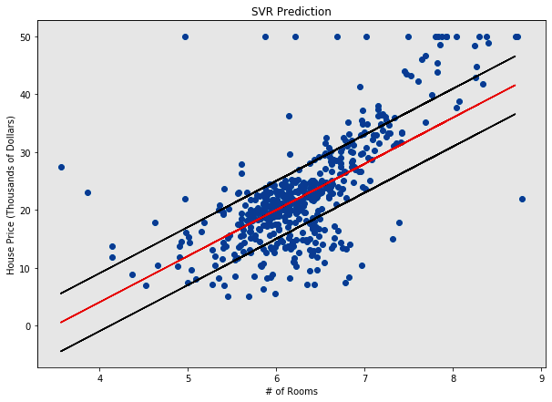
Multiple Linear Regression
Advantages
Dis-Advantages
Support both Linear and non linear regression
Memory Efficient
It is not suitable for large datasets.
Does not perform well when the dataset has much more noise.

Slide 5
Multiple Linear Regression Model
1
from sklearn.linear_model import LinearRegression
2
regressor=LinearRegression()
3
regressor.fit(X_train,y_train)
4
y_pred=regressor.predict(X_test)

Slide 6
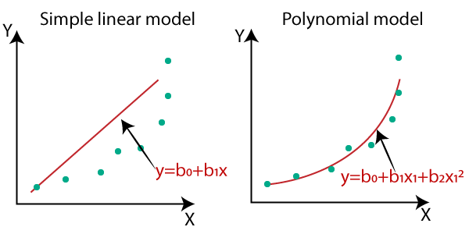
Why polynomial regression
Linear regression requires the relation between the dependent variable and the independent variable to be linear. What if the distribution of the data was more complex as shown in the below figure? Can linear models be used to fit non-linear data? How can we generate a curve that best captures the data as shown below?

Slide 7
What is Polynomial Regression
Polynomial regression is a special case of linear regression where we fit a polynomial equation on the data with a curvilinear relationship between the target variable and the independent variables.
y = m1x1 + m2x1^2 + ... mnx1^n + c

Slide 8
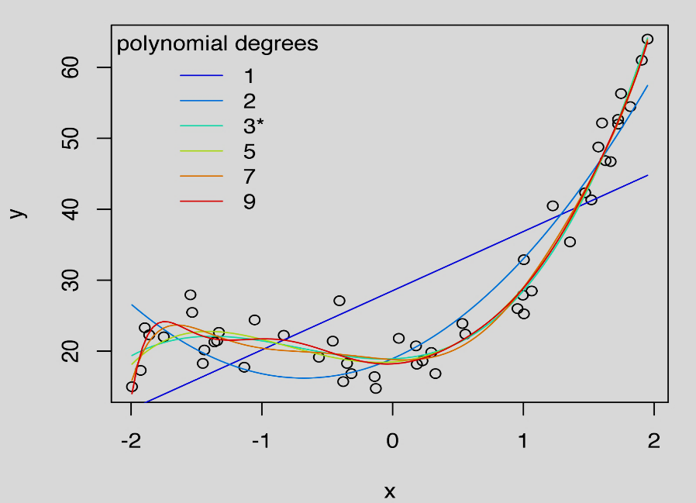
Polynomial Regression
Advantages
Dis-Advantages
The model can fit non linear data better than linear regression
Polynomial basically fits a wide range of curvature.
Too sensitive to the outliers.
As no. of degree increases,chances of overfitting(Memorizing) the data increases

Slide 9
Polynomial Regression Model
1
from sklearn.preprocessing import PolynomialFeatures
2
poly_reg = PolynomialFeatures(degree=n)()
3
X_poly = poly_reg.fit_transform(X)
4
lin_reg=LinearRegression())
lin_reg.fit(X_poly,y)
y_pred=lin_reg.predict(X_test)
5

Slide 10
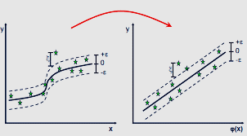
What is Support Vector Regression
We need an algorithm which supports both linear and non-linear regression. as it'll be easy to learn it and use it in any regression problems., and Support Vector Regression is a key to that.

Slide 11
What is Support Vector Regression
In simple regression we try to minimise the error rate. While in SVR we try to fit the error within a certain threshold. This might be a bit confusing but let me explain.
-e <= y-mx-c <= e (e = error rate)
The problem of regression is to find a function that approximates mapping from an input domain to real numbers on the basis of a training sample. So let’s now dive deep and understand how SVR works actually.
Consider these two red lines as the decision boundary and the green line as the hyperplane. Our objective, when we are moving on with SVR, is to basically consider the points that are within the decision boundary line. Our best fit line is the hyperplane that has a maximum number of points.

Slide 12
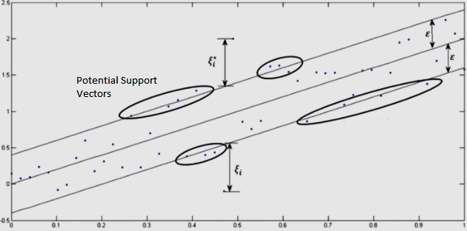
Terms and Hyperparameters
Kernel
error rate(e)
Hyper Plane
tolerance(ei)
Boundary Line
Support vectors

Slide 13
Support Vector Regression
1
from sklearn.svm import SVR
2
regressor = SVR(kernel = 'rbf')
3
regressor.fit(X_train, y_train)
4
y_pred = regressor.predict(X_test)

